Slide 1

Lead Scoring Case Study using Logistic Regression
Team members:
Mansi Singh
Mary Preethi
Lakshya Shakya
November, 2023

Slide 2
Problem Statement
X Education, an educational company, offers online courses tailored for industry professionals. Daily, a multitude of professionals visit their website, exploring the various courses available
Upon completing the form-filling process on their website, individuals are identified as leads by the company. Subsequently, the sales team initiates communication through calls, emails, and other methods. Although this outreach results in the conversion of some leads, a majority remain unconverted
X Education experiences a standard lead conversion rate of approximately 30%. This implies that out of, for instance, 100 acquired leads in a day, approximately 30 are successfully converted. To enhance the efficiency of this process, the company aims to pinpoint the most promising leads, commonly referred to as Hot Leads
Successfully identifying this subset of leads should result in an increase in the lead conversion rate. This is because the sales team will now concentrate their efforts on communicating with the potential leads, rather than making calls to the entire pool of leads indiscriminately

Slide 3
Goals & Objectives
Lead X has requested the development of a model to assign a lead score ranging from 0 to 100 to each lead. This model aims to help identify Hot Leads effectively, thereby increasing the overall lead conversion rate
The CEO has set an ambitious goal of achieving an 80% lead conversion rate for the company. In addition to focusing on the current challenges, there is a strategic interest in developing a model that can effectively navigate future constraints. This includes considerations for peak time operations, maximizing manpower utilization, and establishing well-defined approaches for sustained effectiveness even after the target conversion rate has been reached. The company seeks a comprehensive solution that not only addresses immediate needs but also provides a forward-looking strategy for continuous improvement and success in lead conversion

Slide 4
Solution Approach
Importing and inspecting the dataset
Data preparation
Exploratory Data Analysis (EDA)
Creating dummy variables
Performing test-train split
Scaling features
Analyzing correlations
Building the model
Evaluating the model
Generating predictions on the test data.

Slide 5








Suggestions for Lead Conversion
With an 80% conversion rate target, our aim is to achieve a high sensitivity in identifying hot leads.
With an 80% conversion rate target, our aim is to achieve a high sensitivity in identifying hot leads.
Leads Grouping
Better Communication
Boost Conversion
Leads are categorized according to their propensity or likelihood to convert, leading to the formation of a targeted group identified as hot leads
Having a more concentrated pool of leads for communication enables us to make a more significant impact
Concentrating on hot leads, which are more likely to convert, enhances our potential for achieving an 80% conversion rate
With an 80% conversion rate target, our aim is to achieve a high sensitivity in identifying hot leads.

Slide 6
Data Cleaning
"Select" level signifies null values in some categorical variables where customers didn't make a selection.
Columns with over 40% null values were dropped for improved data relevance.
Handling missing values in categorical columns involved considerations based on value counts.
Irrelevant columns (e.g., tags, country) were dropped for study focus.
Imputation methods were applied to certain categorical variables.
Additional categories were introduced to enhance modeling.
Columns with minimal contribution or featuring a single response category were removed.
Numerical data underwent mode-based imputation after distribution checks.
Skewed category columns were dropped to prevent bias in logistic regression models.
Outliers in TotalVisits and Page Views Per Visit were treated and capped.
Invalid values were rectified, and data standardization was applied (e.g., lead source).
Low-frequency values were grouped as "Others."
Binary categorical variables were mapped.
Various cleaning activities were performed to ensure data quality and accuracy.

Slide 7
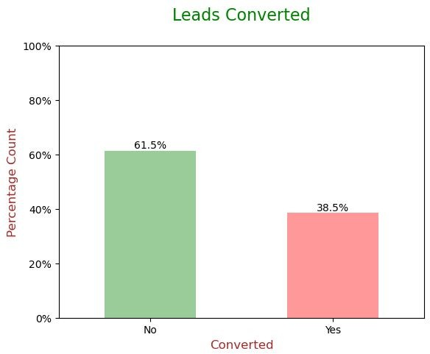
EDA
Data is imbalanced while analyzing target variable.
Conversion rate is of 38.5%, meaning only 38.5% of the people have converted to leads.(Minority)
While 61.5% of the people didn't convert to leads. (Majority)

Slide 8
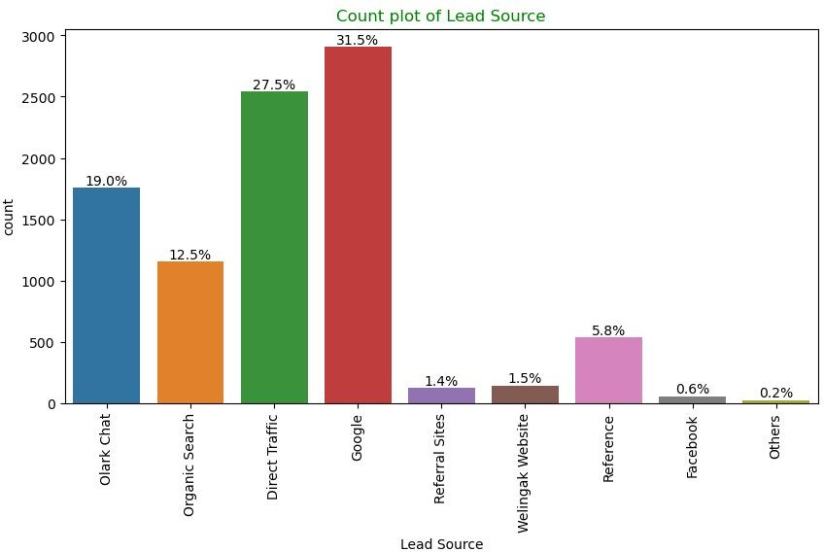
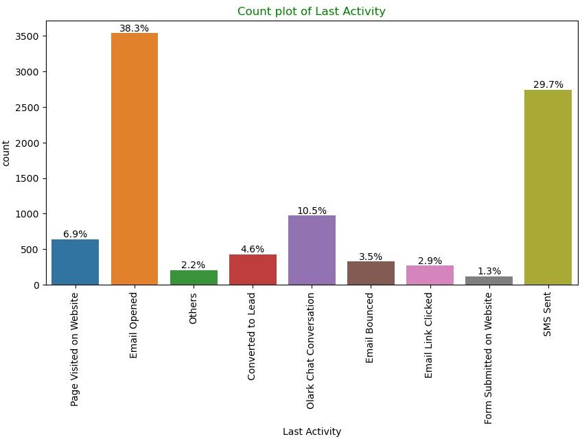
EDA
Univariate Analysis – Categorical Variables
Lead Source: 58% Lead source is from Google & Direct Traffic combined.
Last Activity: 68% of customers contribution in SMS Sent & Email Opened activities.

Slide 9
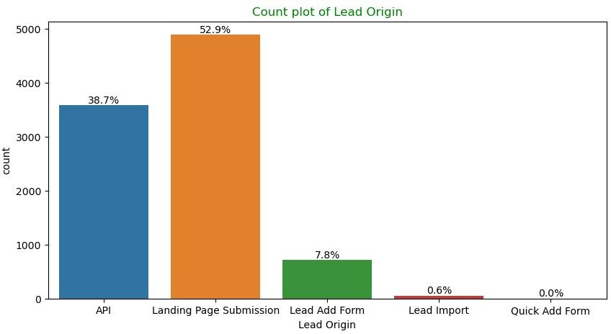
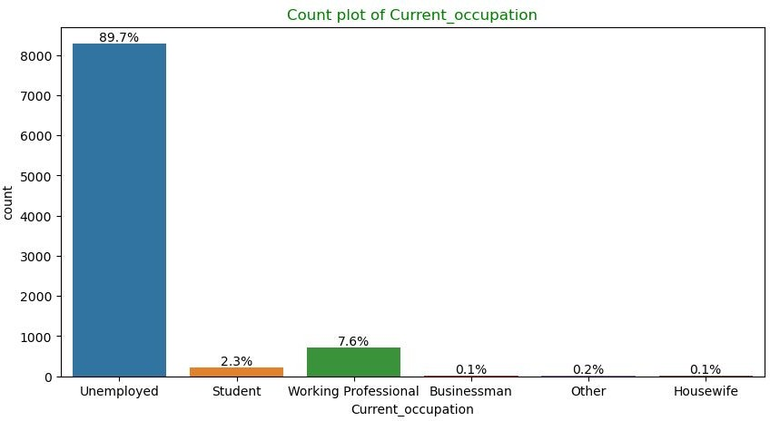
EDA
Univariate Analysis – Categorical Variables
Lead Origin: "Landing Page Submission" identified 53% of customers, "API" identified 39%.
Current_occupation: It has 90% of the customers as Unemployed.

Slide 10
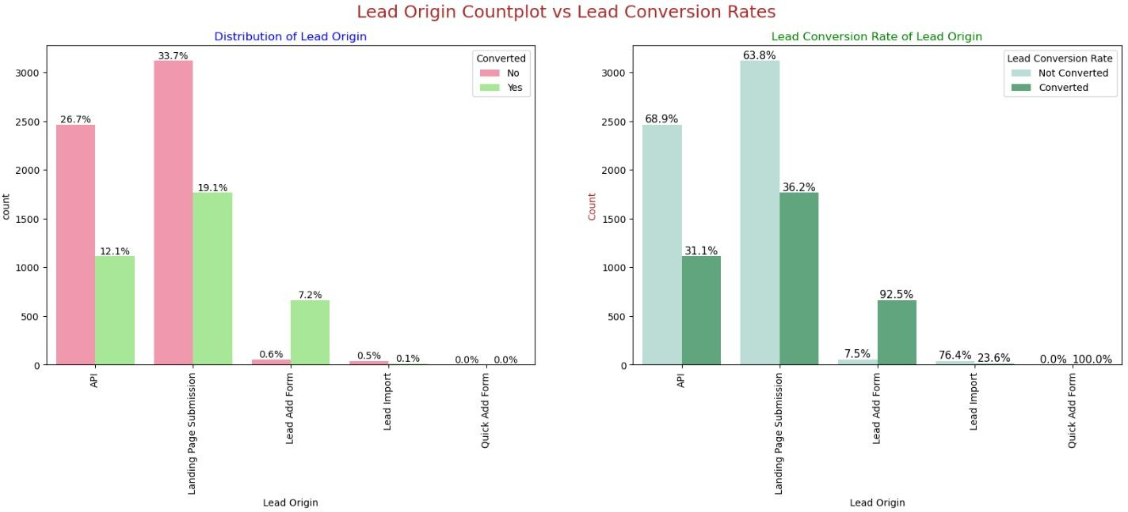
EDA – Bivariate Analysis for Categorical Variables
Lead Origin:
Around 52% of all leads originated from "Landing Page Submission" with a lead conversion rate (LCR) of 36%.
The "API" identified approximately 39% of customers

Slide 11
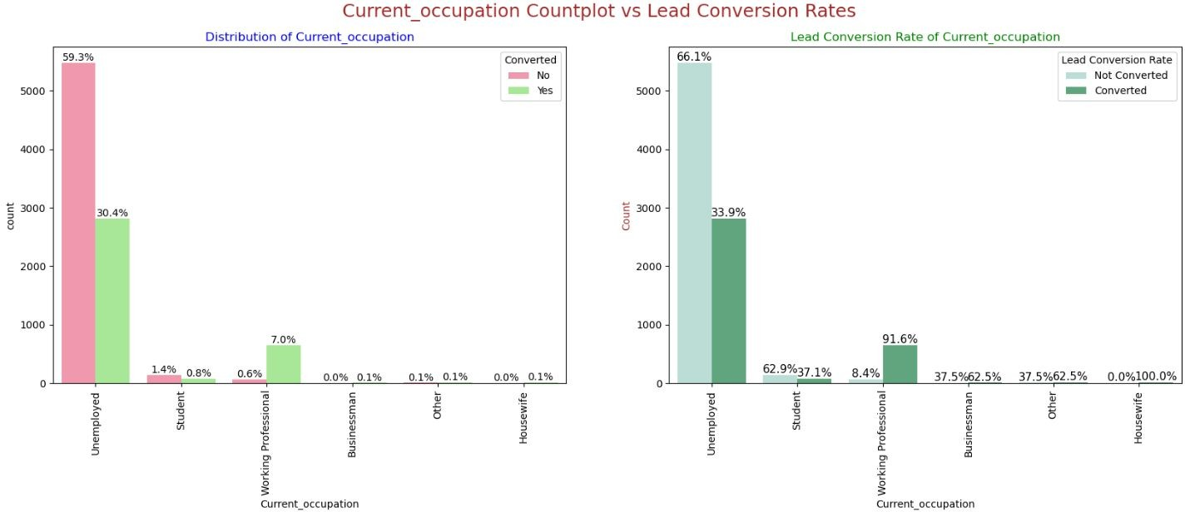
EDA – Bivariate Analysis for Categorical Variables
Current_occupation:
Around 90% of the customers are Unemployed, with lead conversion rate (LCR) of 34%.
While Working Professional contribute only 7.6% of total customers with almost 92% Lead conversion rate (LCR).

Slide 12
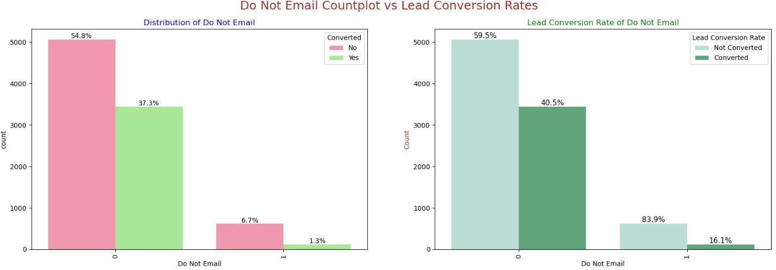
EDA – Bivariate Analysis for Categorical Variables
Do Not Email:
92% of the people has opted that they don't want to be emailed about the course & 40% of them are converted to leads.

Slide 13
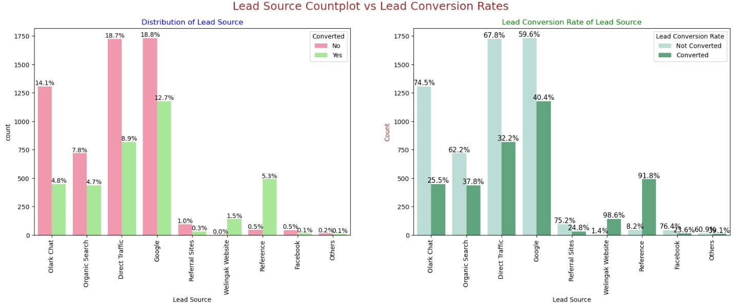
EDA – Bivariate Analysis for Categorical Variables
Lead Source:
●
●
●
●
Google
has LCR of 40% out of 31% customers,
Direct Traffic
contributes 32% LCR with 27% customers, which is lower than Google,
Organic Search
also gives 37.8% of LCR, but the contribution is by only 12.5% of customers,
Reference
has LCR of 91.8%, but there are only around 6% of customers through this Lead Source

Slide 14
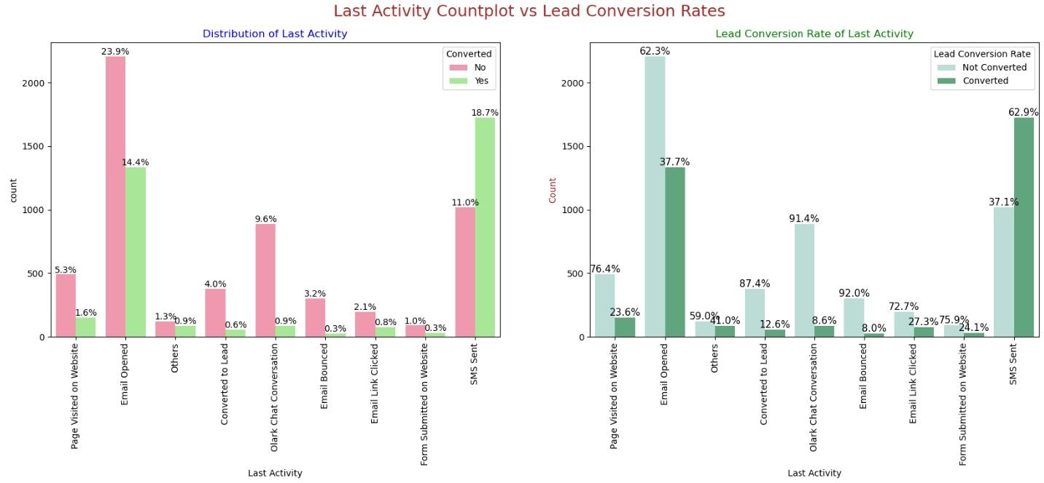
EDA – Bivariate Analysis for Categorical Variables
Last Activity:
'
SMS Sent'
has high lead conversion rate of 63% with 30% contribution from last activities,
' activity contributed 38% of last activities performed by the customers, with 37% lead
Email Opened'

Slide 15
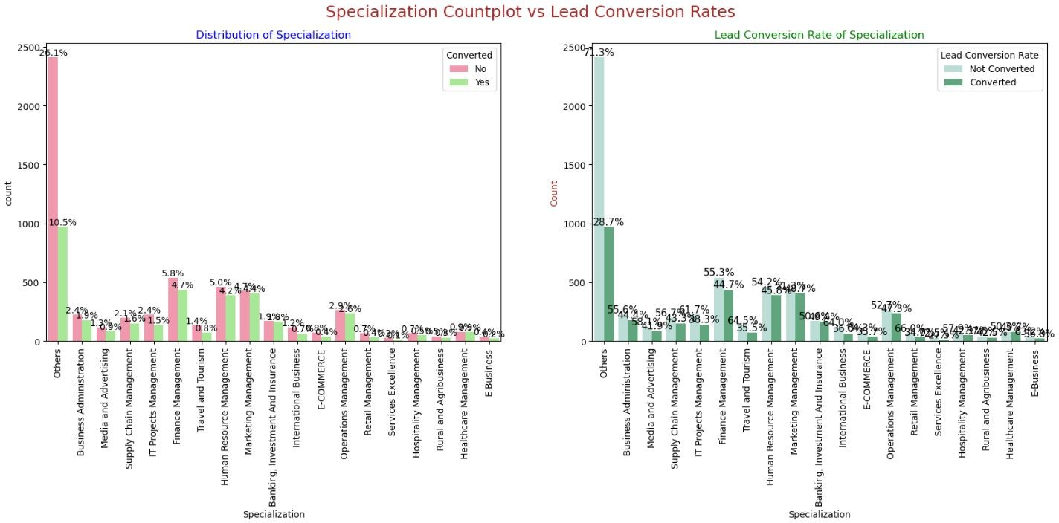
EDA – Bivariate Analysis for Categorical Variables
Specialization:
Marketing Management, HR Management, Finance Management shows good contribution in Leads conversion than other specialization.

Slide 16
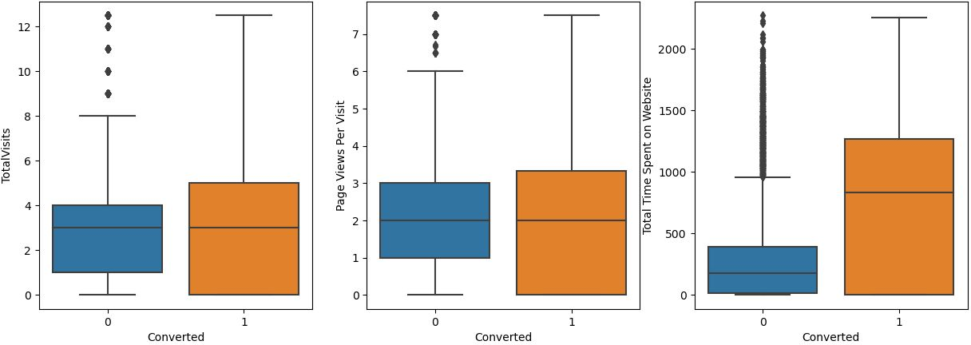
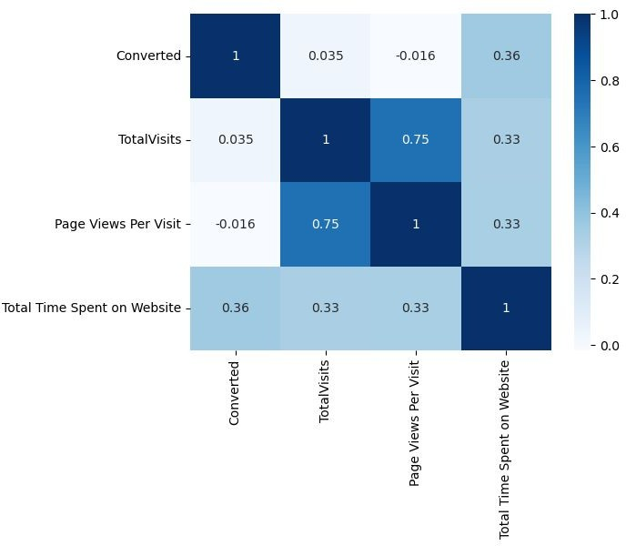
EDA – Bivariate Analysis for Numerical Variables
Past Leads who spends more time on the Website have a higher chance of getting successfully converted than those who spends less time as seen in the box-plot

Slide 17
Data Preparation before Model building
Binary level categorical columns were already mapped to 1 / 0 in previous steps
Created dummy features (one-hot encoded) for categorical variables – Lead Origin, Lead Source, Last Activity, Specialization, Current_occupation
Splitting Train & Test Sets
70:30 % ratio was chosen for the split
Feature scaling
Standardization method was used to scale the features
Checking the correlations
Predictor variables which were highly correlated with each other were dropped (Lead Origin_Lead Import and Lead Origin_Lead Add Form).

Slide 18
Model Building
Feature Selection
The data set has lots of dimension and large number of features.
This will reduce model performance and might take high computation time.
Hence it is important to perform Recursive Feature Elimination (RFE) and to select only the important columns.
Then we can manually fine tune the model.
RFE outcome
Pre RFE – 48 columns & Post RFE – 20 columns

Slide 19
Model Building
Manual Feature Reduction process was used to build models by dropping variables with p – value greater than 0.05.
Model 7 looks stable after seven iteration with:
significant p-values within the threshold (p-values < 0.05) and
No sign of multicollinearity with VIFs less than 5
Hence logm7 will be our final model, and we will use it for Model Evaluation which further will be used to make predictions.c

Slide 20
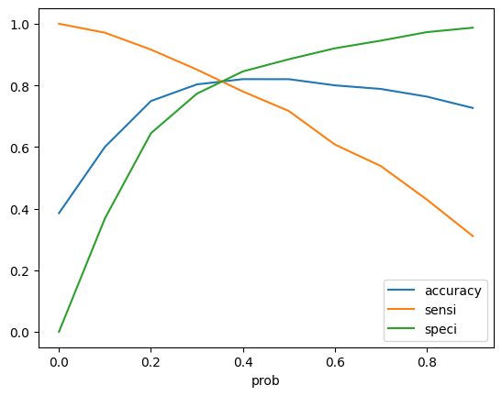
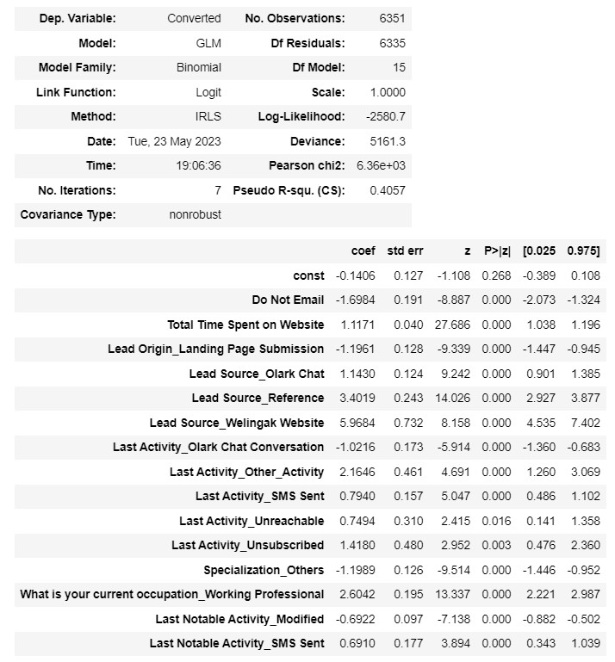
Model Evaluation
Train Data Set
It was decided to go ahead with 0.35 as cutoff after checking evaluation metrics coming from both plots
Confusion Matrix & Evaluation Metrics with 0.35 as cutoff

Slide 21
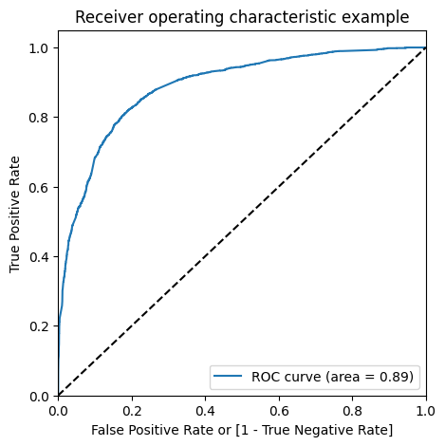
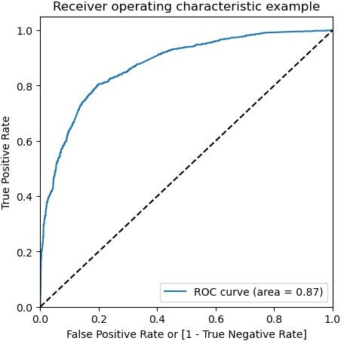
Model Evaluation
ROC Curve – Train Data Set
Area under ROC curve is 0.88 out of 1 which indicates a good predictive model.
The curve is as close to the top left corner of the plot, which represents a model that has a high true positive rate and a low false positive rate at all threshold values.

Slide 22
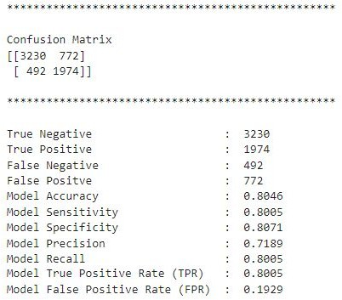
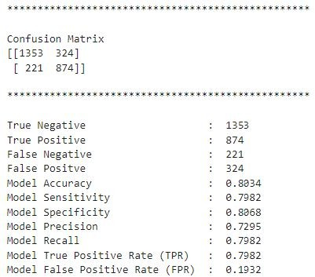


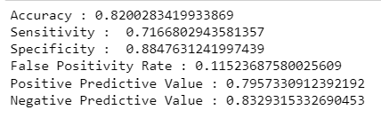
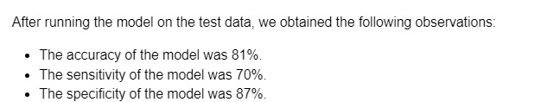

Model Evaluation
Confusion Matrix & Metrics
Train Data Set
Test Data Set

Slide 23
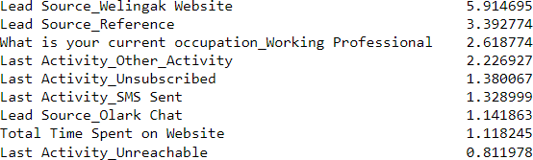

Recommendation based on Final Model
As per the problem statement, increasing lead conversion is crucial for the growth and success of X Education. To achieve this, we have developed a regression model that can help us identify the most significant factors that impact lead conversion.
We have determined the following features that have the highest positive coefficients, and these features should be given priority in our marketing and sales efforts to increase lead conversion.
We have also identified features with negative coefficients that may indicate potential areas for improvement. These include:

Slide 24
Conclusion
Identified as crucial indicators among potential buyers are several key variables:
The total time spent on the website
The overall number of visits
Specific lead sources, including Google, direct traffic, organic search, and visits to the Welingak website
The timing of the last activity, with a focus on SMS and Olark chat conversations
Lead origin marked as "Lead add format”
Individuals currently employed as working professionals
Taking these factors into consideration, X Education stands poised for significant success, as the organization possesses a substantial opportunity to engage effectively with nearly all potential buyers, influencing their decisions and encouraging them to enroll in the offered courses

Slide 25
Recommendation based on Final Model
Strategies to Increase Lead Conversion Rates:
Prioritize features with positive coefficients for targeted marketing efforts.
Develop strategies to attract high-quality leads from top-performing lead sources.
Optimize communication channels based on their impact on lead engagement.
Tailor messaging to engage working professionals effectively.
Allocate a higher budget for advertising and promotional activities on the Welingak Website.
Introduce incentives or discounts for providing references that convert into leads, encouraging more referrals.
Aggressively target working professionals, considering their high conversion rates and potentially better financial situations.
Areas for Improvement Identification:
Analyze negative coefficients in specialization offerings to identify potential areas for improvement.
Review the landing page submission process to identify and address areas that can be enhanced for better conversion outcomes

